Slide 1
Balancing Innovation & Stability
KubeCon NA 2024
Jago Macleod
Engineering Director, GKE & Kubernetes, Google
@jagosan

Slide 2
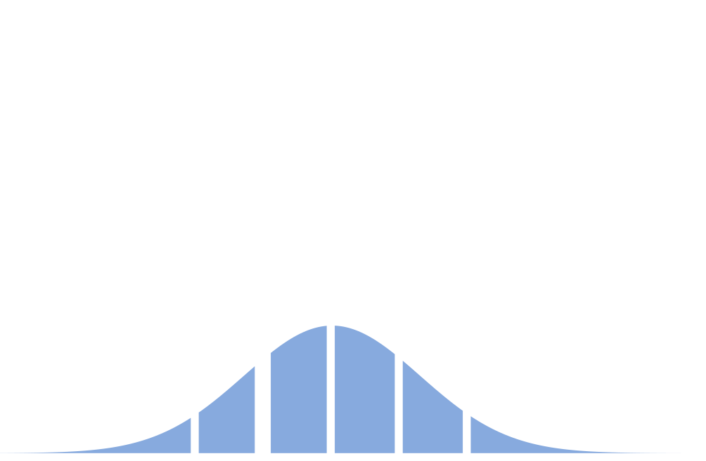
Expected Kubernetes / container adoption curve
Kubernetes was following a standard innovation adoption curve.
K8s crossed the chasm circa 2018, and has since moved well into the pragmatists / early majority.
Starting to penetrate into the conservatives / late majority.
So far so good…
You are
HERE

Slide 3
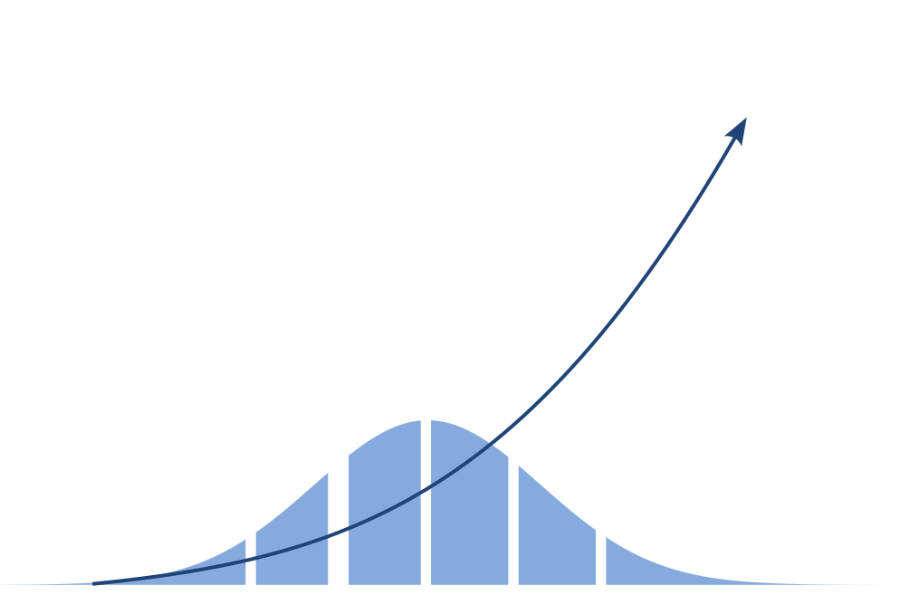
Expected Kubernetes / container consumption curve
Critically, the consumption curve is dramatically different from the adoption curve.
Those ‘late majority’ and ‘laggards’ have some pretty big workloads.
And the laggards are workloads, not people or companies. There are extremely sophisticated companies with lagging teams or workloads for legitimate reasons.
Again, so far so good…
You are
HERE

Slide 4

But… Plot Twist!!
Batch, ML, and GenAI workloads ignited sudden exponential growth in compute consumption via Kubernetes clusters.
Expansion to Telco, Retail Edge accelerates growth
Catastrophic Success…
… or just Catastrophe?
Notes:
Then, of course, the plot twist: the rapid rise of batch, ML, and GenAI. Just like for consumers who are finding new ways to leverage AI, this shift has had a profound impact on the Kubernetes project in multiple dimensions.

Slide 5
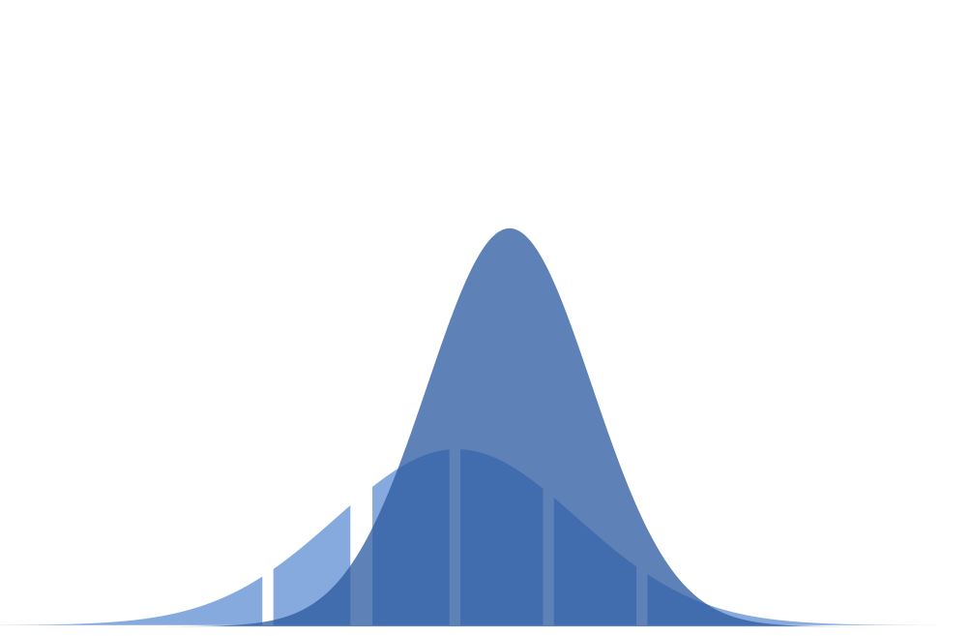
Overlapping, stacking, adoption curves…
Instead of a single adoption curve, there are now multiple, overlapping adoption curves going on.
Containers and Kubernetes are still on the upswing, but in the ‘maturing’ phase.
The AI/ML adoption curve is significantly steeper, and includes new use cases that break many assumptions.
This should be interesting!
You are
HERE

Slide 6
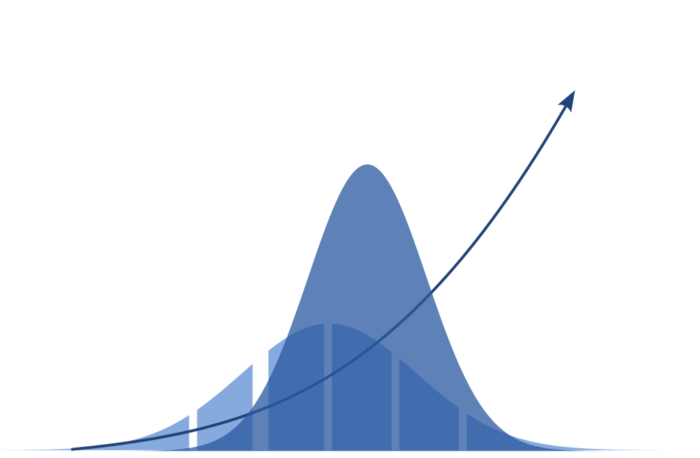
Overlapping, stacking, adoption curves…
Remember that accelerating consumption curve we discussed earlier?
Looks kind of quadratic?

Slide 7
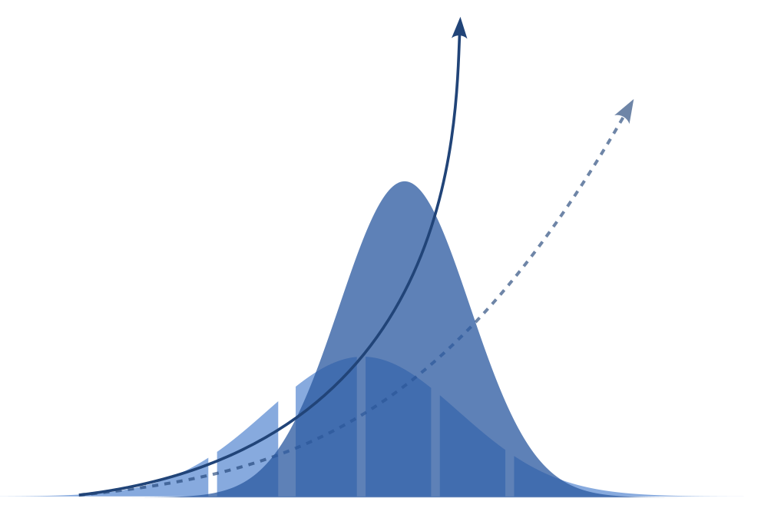
Overlapping, stacking, consumption curves!
It just went exponential.
Challenge: focus attention & energy to move from the anticipated curve to the observed consumption curve.
You are
HERE
You are
HERE

Slide 8
OSS K8s @ Google: Mission
Ensure the future of OSS Kubernetes, and the supporting ecosystem, for the next decade by meeting the needs of the next trillion core hours… NOW
Ensure the future: Remain healthy and relevant
OSS Kubernetes, and the supporting ecosystem:
The next decade: Need to consider the next 10 years as a reasonable time horizon
Next trillion core hours: Need to evolve for new workloads, especially in batch and AI/ML
Despite the long time horizon, there is urgency NOW - the next decade has already begun!
Notes:
So, what to do?
We decided to use this pivotal moment as a forcing function to refocus.
Redefine Kubernetes relationship with hardware
Evolve from Workload Orchestration to Framework Orchestration

Slide 9
Three K8s Core Stories to Rally Around in 2024
Improve Reliability at Scale, and across Upgrades
New workloads require unprecedented scale, and have new architectures and failure modes.
And with accelerating growth and complexity, upgrade reliability is more urgent than ever before.
Keywords: Upgrade Reliability, LTS, Testing, Engineering Excellence
Redefine Kubernetes Relationship with Hardware
Kubernetes was designed for commodity, ~uniform CPU compute.
But GPUs and TPUs are expensive, sparse, and non-uniform. Even CPUs and networking are evolving rapidly.
Keywords: Elastic resources, GPU Sharing and flexibility, in-place pod updates
From Container & Workload to Framework Orchestration
We started running simple stateless web apps and expanded from there.
Today, ISVs and end users are stretching Kubernetes to run special-purpose frameworks like Spark and Ray.
Keywords: batch, ML, GenAI training and inference, frameworks
01
02
03
01
03
Notes:
01: Extended / Long Term Support creates a new challenge, risking customers stuck on older versions.
02: K8s was designed for commodity, broadly available, and roughly uniform CPU compute, but GPUs and TPUs are expensive, sparse, and non-uniform.
Simple things must remain simple, while complex things and new workloads become possible.
03: Evolve Kubernetes from a container & workload orchestrator into a framework orchestrator.
Multiple, best-in-class frameworks optimized for specialized workloads are enabled at near-native performance, and benefit from a single, consistent governance and operational model.
Batch, ML, and GenAI workloads are run by practitioners in the framework of choice, and benefit from the operational expertise of their platform teams.

Slide 10

01: Reliability at Scale
Pods per node
Nodes per cluster
Clusters per region
Regions per customer
Memory, CPU, Storage, GPU/TPUs
Services, Routes, IPs, ….
Every aspect in every dimension
You are
HERE
You are
HERE

Slide 11
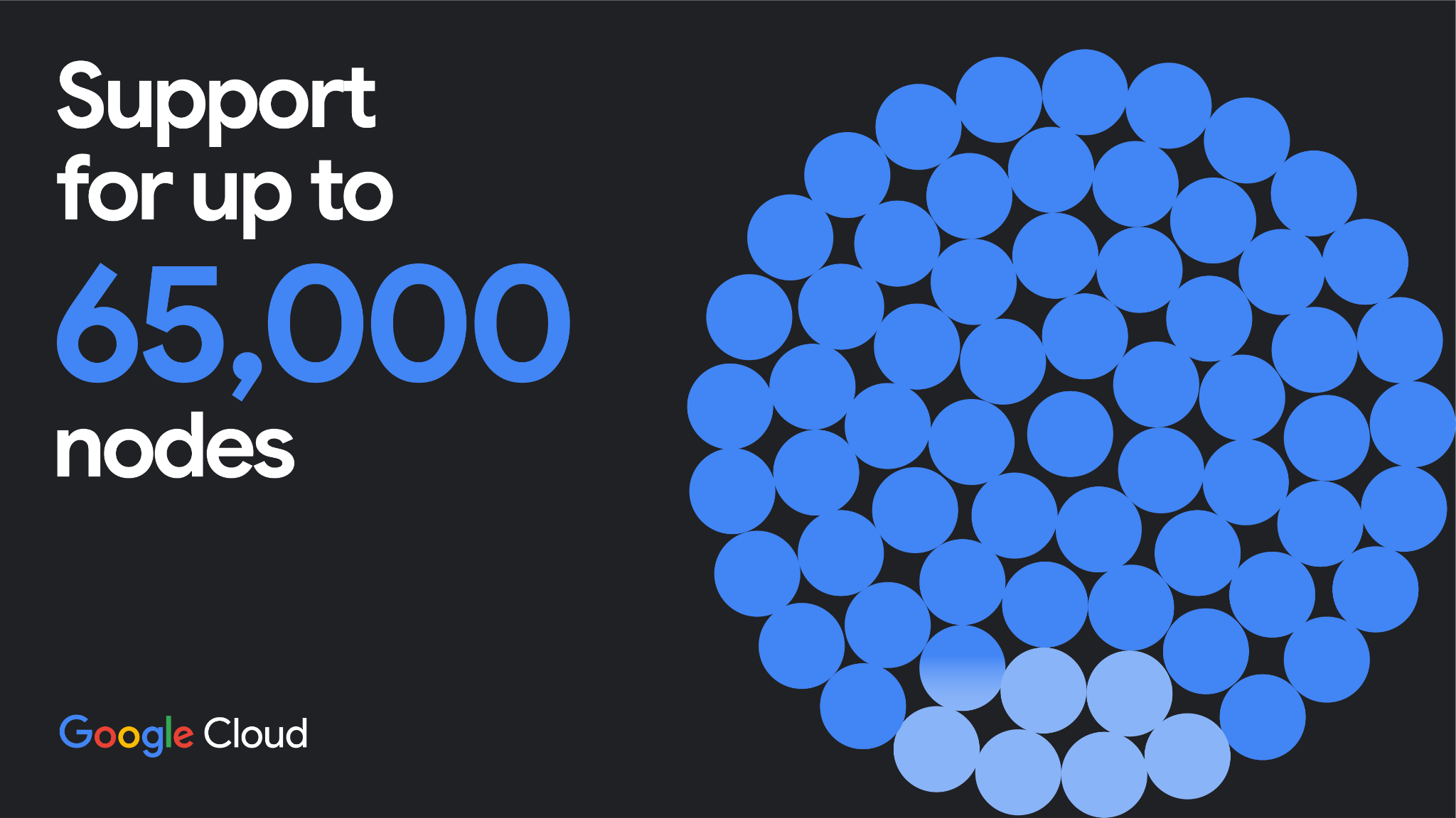

Pushing the boundaries of scalability in your workloads!
Notes:
Speaking of scalability, GKE is pushing the boundaries of cluster scalability with support for staggering 65,000-node clusters — with the power to propel ground-breaking innovation forward.

Slide 12
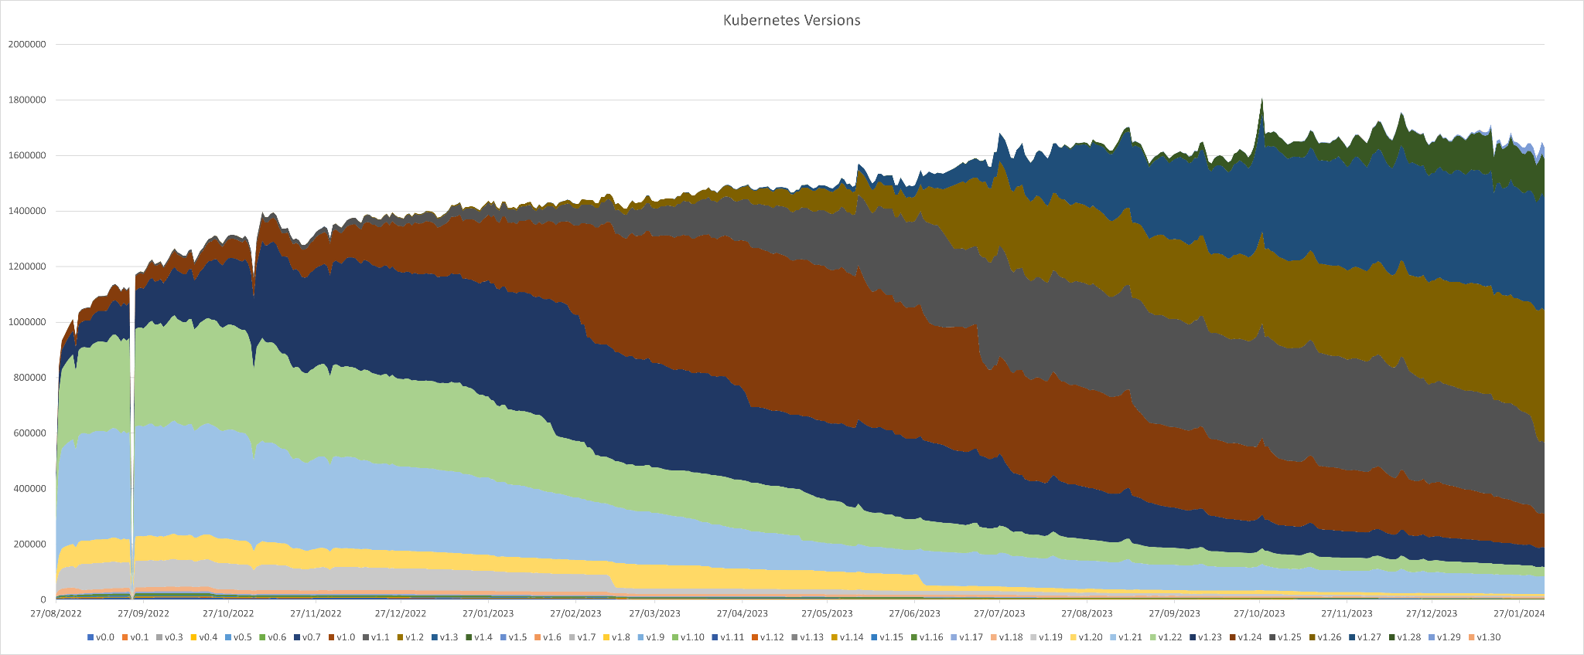
01: Upgrade Reliability
Enable all Kubernetes users to remain on supported versions of Kubernetes so that they can benefit from innovation supporting new workloads.
I have a dedicated talk later today on this topic - please join!
Kubernetes Versions as of Feb 2024
You are
HERE
You are
HERE
Notes:
https://raesene.github.io/blog/2024/02/17/a-final-kubernetes-censys
Kubernetes is already widely adopted. Innovation only for new users, or new clusters, will severely limit the impact.
Increased availability of LTS options may lead many to remain behind, reducing the addressable market and increasing likelihood of disruption - to older clusters and to the ecosystem.

Slide 13



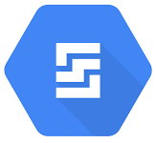

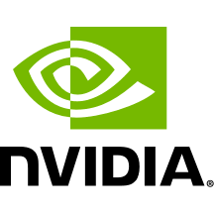
02: Redefine Kubernetes Relationship with Hardware
Before
After
Kubernetes API
Kubernetes API
K8s Node
K8s Node
CPU
CPU
Persistent Volume
Google TPU
GPU
Persistent Volume
Google TPU
GPU
Notes:
Previously, Kubernetes only had to deal with CPU and Memory. GPUs, NICs, even CPUs are evolving much more rapidly than in the past.
Users need to know internals of devices like GPUs and NICs, managed through device plugin APIs; solution was static, limited, and often leads to bypassing K8s API through privileged pods.
We have been working hard with partners like Intel and Nvidia to evolve Kubernetes to manage GPUs, TPUs, NICs and more
This allows workloads to be share Accelerators, and allows schedulers and autoscalers to reason about these devices in through Kubernetes-native abstractions.
This makes workloads more portable, flexible, and resilient.

Slide 14
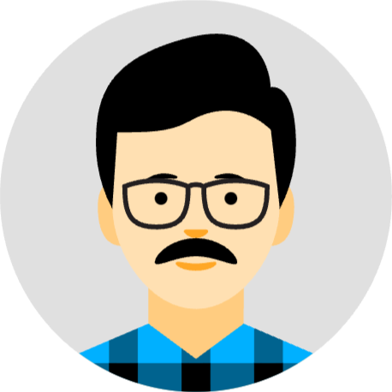


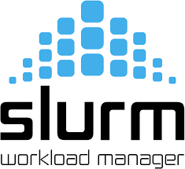
03: Framework Orchestration
Before
After
?
??
API - General
API - Specialized
API - Specialized
API - General
API - Specialized
API - Specialized
Infrastructure: Segmented & Siloed
Infrastructure: Consistent
Notes:
Read this slide from Left to Right
Before: Data Scientists and Data Engineers work through specialized APIs against Specialized hardware.
But the Platform Admin has no knowledge or control over these new frameworks. Security, billing (charge-back), policy, auditability, and more – all are fragmented or partial solutions.
After: We’re working to evolve kubernetes together with frameworks like Spark, Slurm, and Ray
Many frameworks do work with or on Kubernetes, e.g., as an infrastructure provisioning. But often succeed “in spite of” rather than “because of” Kubernetes
After:

Slide 15




Consistent Consumption & Operational Model
API - General
Kueue
Kubeflow
?
…
Notes:
Platform Admins / Engineers work through a consistent operational model across all workloads, including those that depend on new frameworks…
While Data Scientists and Data Engineers are able to work through familiar, best-in class frameworks and APIs.
Critically, we’re looking ahead to frameworks that haven’t even been invented yet!

Slide 16
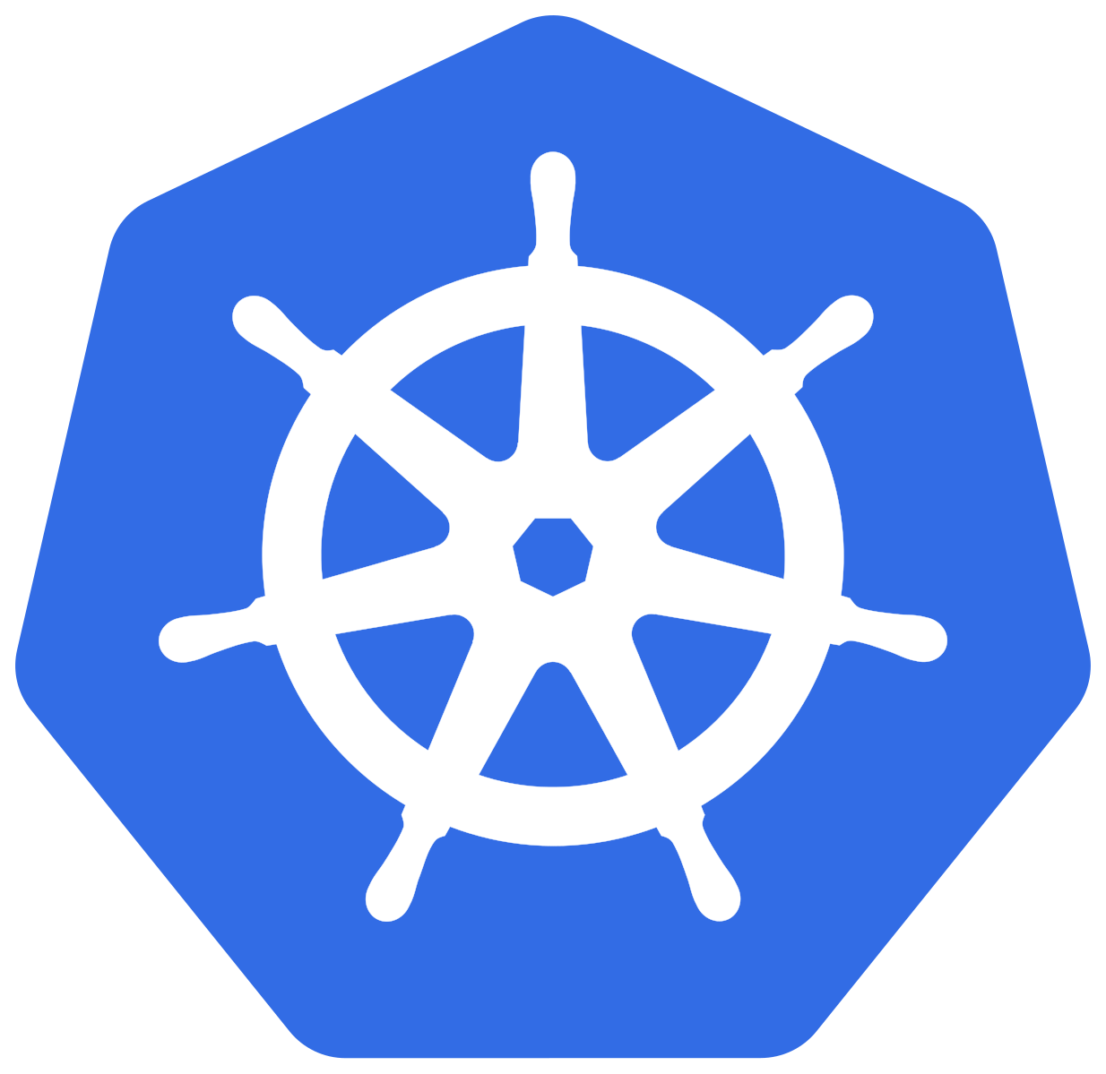
Overlapping, stacking, opportunities… of a lifetime
There is so much to be proud of in what we have accomplished together.
Now we’re Doubling Down on K8s
Innovate to meet the needs of the next Trillion Core Hours
While simultaneously
Improving stability.
We can’t wait to invent the future together.

